Slide 1
Fraud Detection
Capstone
Notes:
Intro Self

Slide 2
Special Thanks
Shriyash Jagtap from Kaggle
Notes:
Shriyash JagTap for providing this synthetic dataset on Kaggle for providing this synthetic dataset (Jagtap, 2024).

Slide 3
Hypothesis
Null Hypothesis-. The Gradient Boosting model doesn’t have a recall greater than 70%.
Alternate Hypothesis-. The Gradient Boosting model has a recall greater than 70%.
Notes:
Research Question: Can I create an effective gradient-boosting model to detect fraud in e-commerce transaction?
Context: This capstone will demonstrate my skills in machine learning models. It will demonstrate how I can utilize a ML to classify fraudulent behavior for an organization effectively (Kaila, 2024).
Recall: will show the model’s strength in predicting actual fraud (Madarshanian, 2024).

Slide 4
Data Science Process
Downloading the DF
Cleaning the DF
Data Preprocessing
Univariate and Bivariate Analysis
Feature Selection
Encoding/Split/Train
Baseline Gradient Boosting Model
Hyperparameter Tuning
Notes:
Utilized Pandas to create a df and remove unnecessary columns.
Cleaned false records of customers’ ages being less than 15. I removed IP addresses as there weren’t many duplicates showing relationships.
Analysis revealed a sparsity of fraudulent transactions in comparison to legitimate transactions.
Utilized random under-sampling to balance the data, as there was well over a million datapoints.
Label Encoding for ordinals, one hot encoding for other categoricals, and (true/false) Booleans. 80/20 split.
I created my first gradient-boosting model as a baseline model. It’s high recall (100%) and low accuracy and precision of 5%, model was dramatically overfitting
Utilized RandomizedSearchCV for hyperparameter tuning, so I could increase performance with lower computational cost (Tuning XGBoost Hyperparameters with RandomizedSearchCV, n.d.).

Slide 5

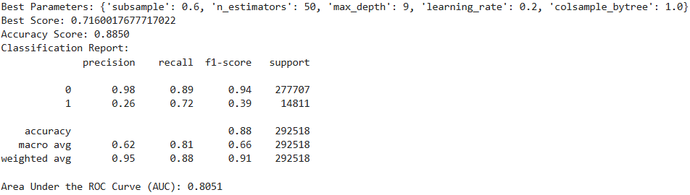
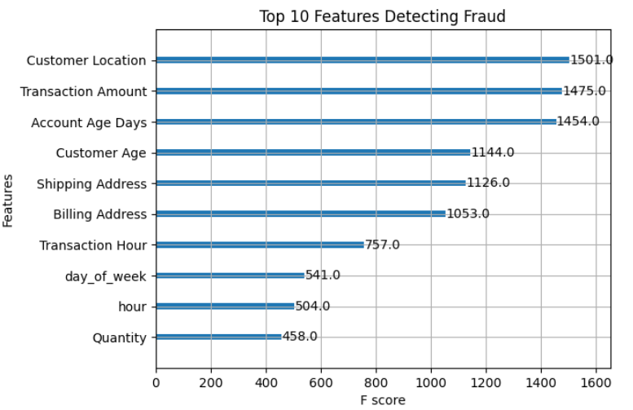
Results
Notes:
With these results, we reject the null hypothesis, as my model has a recall higher than 70%.
72% Recall. Predicting 72% of the fraud. Low precision at 26% demonstrates there will be plenty of red flags for legitimate transactions.

Slide 6
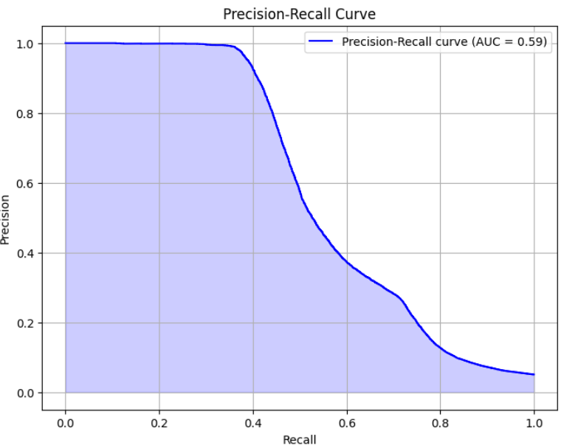
Limitations
Low Precision
Low F1-Score
Recall could be better

Slide 7
Proposed Actions
Further Improvement
Notes:
We have a great starting point where the model classifies 72% of the fraud.
With the low precision, I suggest further development.
Look into: -Removing multicollinearity
-A more computational heavy hyperparamter tuning tool like GridSearchCV
-Testing other models like Neural Networks

Slide 8

Expected Benefits of this Study
ML model that predicts over 70% of fraud.
Improved Fraud Detection.
Demonstrated expertise in using a ML model to solve a business problem.

Slide 9
THANK YOU
Margot Smith
msmit296@wgu.edu

Slide 10
References
Brownlee, Jason. (2021, January 5). Random Oversampling and Undersampling for Imbalanced Classification. Machine Learning Mastery. https://machinelearningmastery.com/random-oversampling-and-undersampling-for-imbalanced-classification/
Jagtap, Shriyash. (2024, April 7). Fraudulent E-Commerce Transactions. Kaggle. https://www.kaggle.com/datasets/shriyashjagtap/fraudulent-e-commerce-transactions
Madarshanian, Ramin. (2024, April 4). Precision & Recall: When Conventional Fraud Metrics Fall Short. Kount. https://kount.com/blog/precision-recall-when- conventional-fraud-metrics-fall-short
Tuning XGBoost Hyperparameters with RandomizedSearchCV. (n.d.). Stack Overflow. https://stackoverflow.com/questions/69786993/tuning-xgboost- hyperparameters-with-randomizedsearchcv

